Slide 1
Bare metal OS project

Slide 2
Changes from the usual project
BMOS milestones are considered Advanced Labs (but be aware you must do them in order)
You can do the project individually or with a group member of your choice (please only have 1 person submit on Moodle, but include a textfile that tells the TA who the other is)
You aren’t required to create a Git repo (though of course you can) – you’ll submit via Moodle

Slide 3
Advice for virtual collaboration
MS vscode live share
MS Teams Screen Share/Remote Control

Slide 4
Building an OS from scratch
5 week project for an introductory OS course
Designed by Michael Black at American University
http://www.michaeldblack.org

Slide 5
Bare metal system
No simulator
No underlying system
No prewritten code

Slide 6
Key Characteristics
Be bare metal:
boot loading, disk drivers, console drivers
Be "real":
program execution, interrupts, processes
file system, shell

Slide 7
Finished OS Characteristics
Has all functionality of older OS like CP/M
Can execute a program from a file
Command-line shell with necessary commands:
Directory listing, type, copy, execute
Multiprocessing and basic memory management

Slide 8
Goals
Minimize total lines of code
Minimal pre-written assembly code
Students write own kernel and all C functions
3 components - bootloader, kernel, shell
Run on Qemu simulator to develop and debug
Qemu is an x86 hardware platform simulator

Slide 9
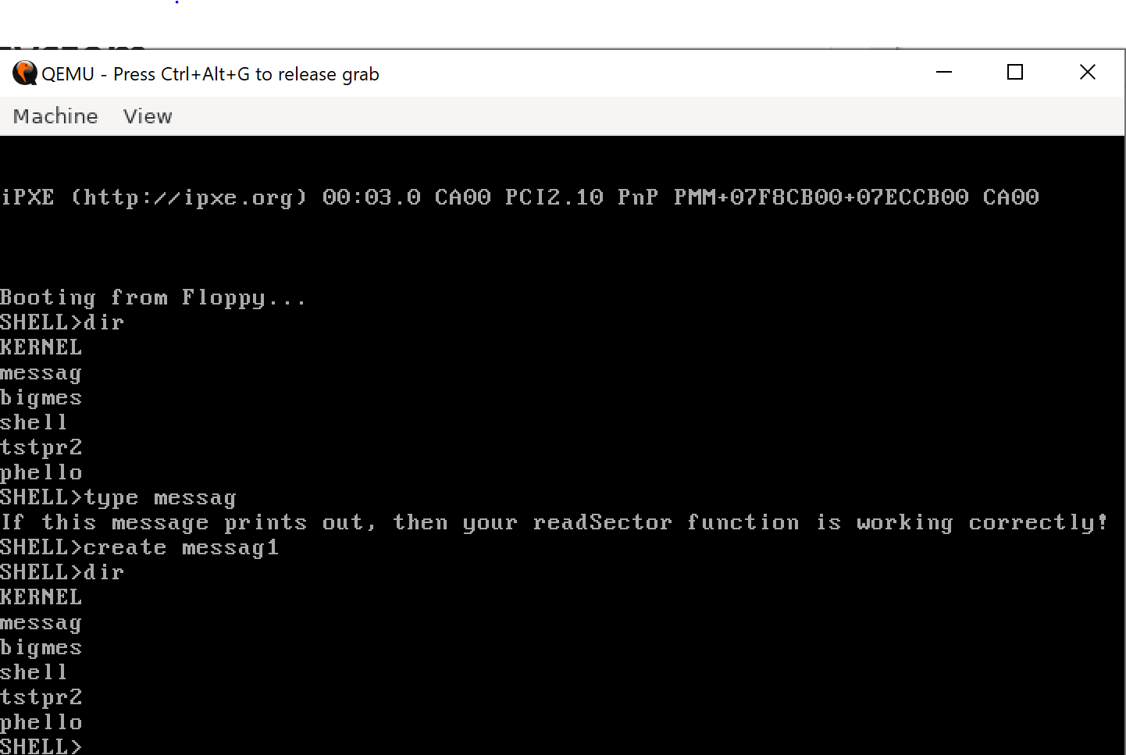
Notes:
9

Slide 10
Skills needed
Skills that you need to complete the project
x86 Segmentation
UNIX Commands
C Programming Language Basics
Programming for bcc
Define variables on the top of the block/function
Use /* */ to comment

Slide 11
General advice
Code together, as a group, rather than attempting to divide tasks
Inform me of group problems *before* they become major issues
Work ahead of the milestone deadlines
Debug in a sane way: when weird stuff is happening get visibility into the problem

